Slide 1
REU Program at ECU "Software Testing - Foundations, Tools, and Applications
Mobile Testing Using MonkeyRunner
Ernest Holston and Brandi Amstutz

Slide 2
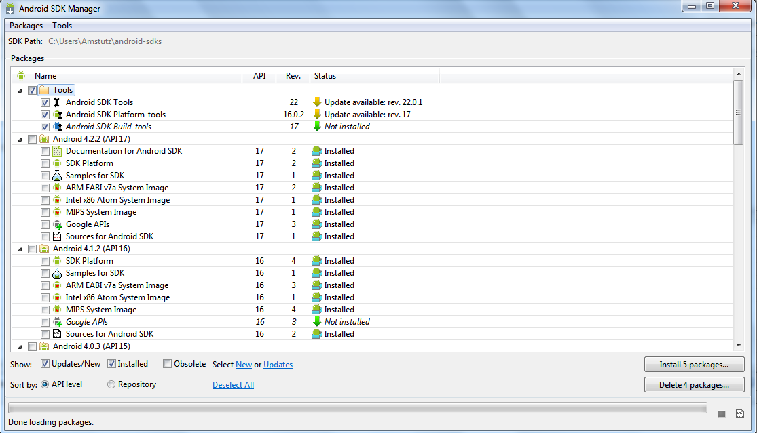
Mobile Development
Set of processes and procedures involved in writing software for a small, wireless computing device such as smartphones or tablets¹
Software development kits (SDKs) are available for most mobile platforms (Android, BlackBerry, Apple, etc.) and provide a range of developer tools necessary to create mobile applications
Android SDK
Tools to build, test, and debug Android apps
Open source/no cost
SDK download available here

Slide 3
Mobile testing
Crucial element of software development
Application should function on devices with different:
Operating Systems
Device manufacturers
Memory
Screen resolution
Screen size
Sensor hardware
Types (smartphone or tablet)
Data Connection

Slide 4
Automation tools
Automation tools save time and money by using test scripts to repeat a test procedure multiple times
Increase the speed of regression tests
Examples:
Robotium
Supports Android OS
Automatic black box test cases
Free to download
Testdroid Cloud
Supports Android OS
Fully Automated testing on a cloud of devices
Calabash
Supports Android and iOS
Open source/free to download
Android SDK
MonkeyRunner

Slide 5
What is MonkeyRunner?
MonkeyRunner is a tool that provides an Application Programming Interface (API) for writing programs that control an Android device.²
Interactive through command prompt using Jython
Use commands to write a script

Slide 6
MonkeyRunner Modules
MonkeyRunner
Class of utility methods
Provides methods that
MonkeyDevice
Represents a device or emulator
Provides methods that simulate interactions
MonkeyImage
Represents a screen capture image
Provides methods related to screen captures

Slide 7
Command Examples
touch(integer x, integer y, string type)
type represents a key event (DOWN, UP, DOWN_AND_UP)
type(string message)
wake()
writeToFile(string fileName, string format)
sameAs(MonkeyImage otherImage, float percent)
Percent indicates the percentage of pixels that need to be the same for the method to return true

Slide 8
Technical components
Eclipse IDE
PyDev Extension for Eclipse
Jython
Android SDK
Android Debug Bridge
Command line tool that allows interaction with a connected device
Android Package (APK) for the application to be tested
File format used to install applications on Android OS
Android device connected through USB (or emulator)
Android drivers for specific device installed on computer

Slide 9


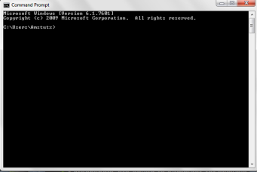

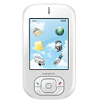
testScript.py
Console
.apk file
Screenshots are saved to file
Android device connected
via USB

Slide 10
Run .py script from console
Connection with device is made
Script installs .apk file on device
Script commands execute
MR screenshots saved to file

Slide 11
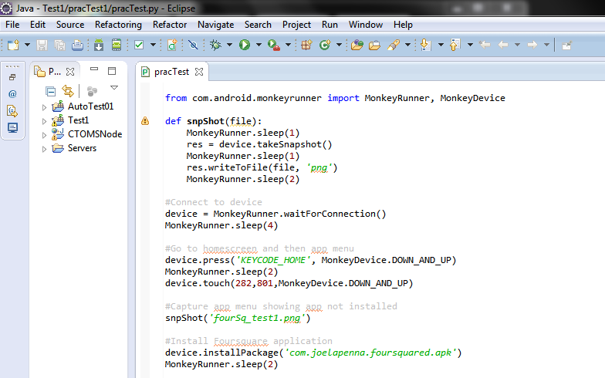
script

Slide 12
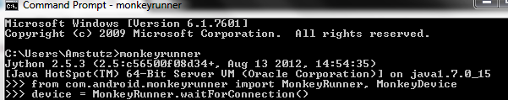
programming languages: python and jython
Python
Clear and powerful object-oriented programming language, comparable to Perl, Ruby, Scheme, or Java³
Open source/free to download
Python provides a Beginner's Guide
Code examples from this basic tutorial
Jython
Implementation of the high-level, dynamic, object-oriented language Python seamlessly integrated with the Java platform⁴
Allows you to run Python on Java platform
Free to download
IBM’s tutorial
Using Jython with MonkeyRunner interactive command line tool:

Slide 13
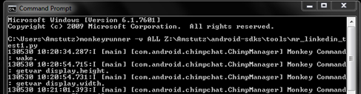
Executing Test script from command prompt
Use the following command format:
monkeyrunner –v ALL <direct path to .py script>

Slide 14
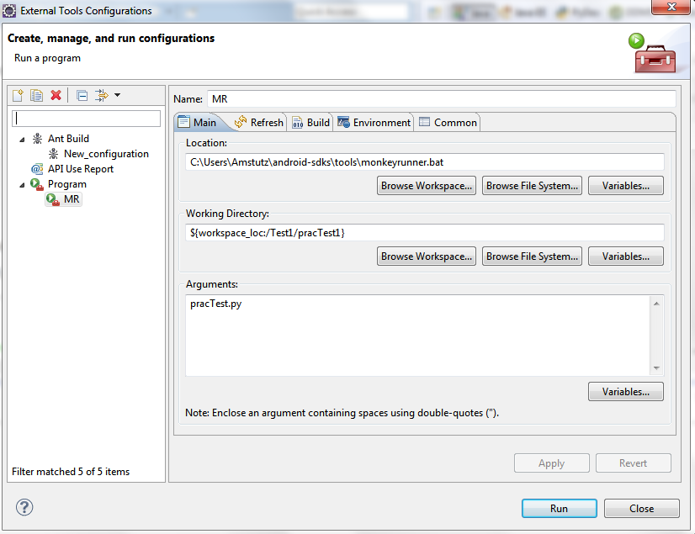
Executing test script from from eclipse

Slide 15
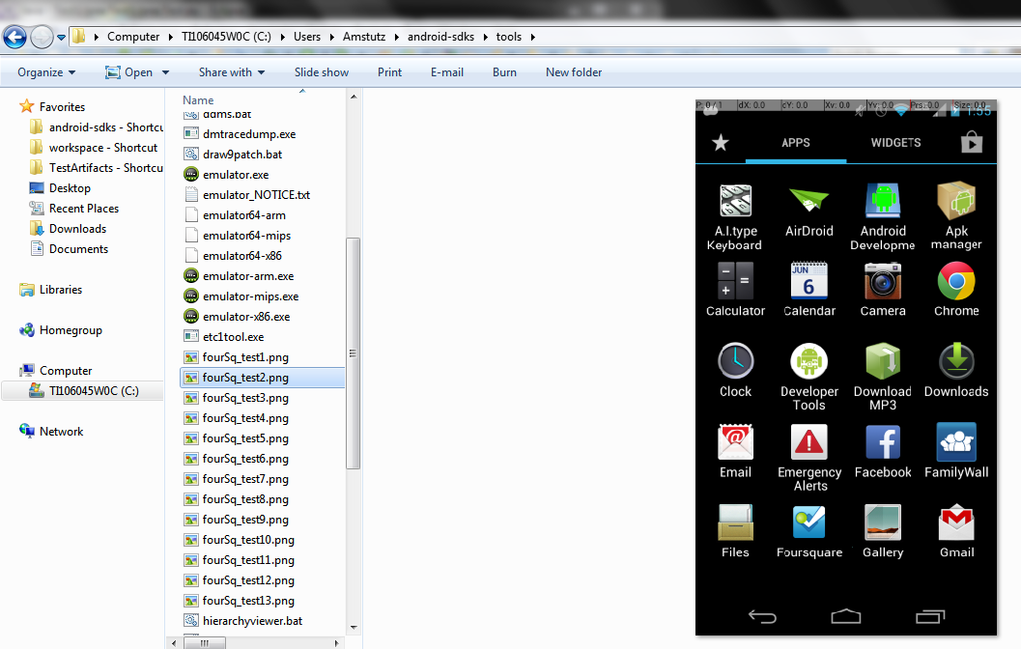
screenshot feature
MonkeyRunner allows scripts to write screen captures to a file for analysis

Slide 16
Screenshot analysis
ECU Mobile application provides access to mobile versions of
Blackboard
OneStop
Joyner Library
ECU transit
and more!
Compare the user interface on a smartphone and a tablet:
 | Smartphone | Tablet
Device Manufacturer | Motorola | Samsung
Model | RAZR M | Galaxy Tab 2 7.0
OS | Android 4.1.2 | Android 4.1.1
Screen Size | 4.3” | 7.0”
Screen Resolution | 960 x 540 qHD | 1024 x 600
Memory | 1 GB RAM/8GB ROM | 8 GB
Connection Type | Wi-Fi | Wi-Fi

Slide 17
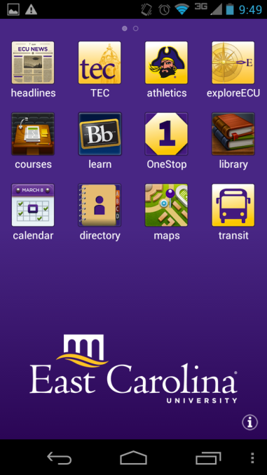
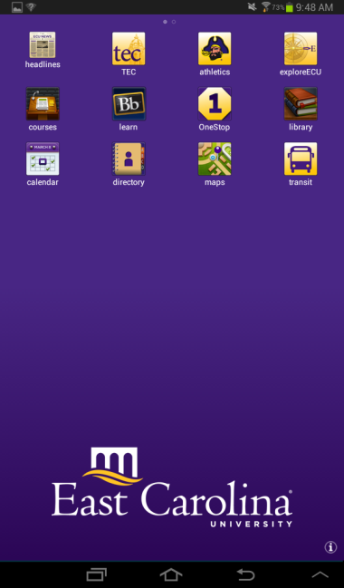
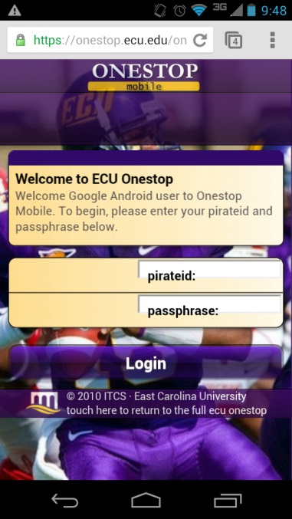
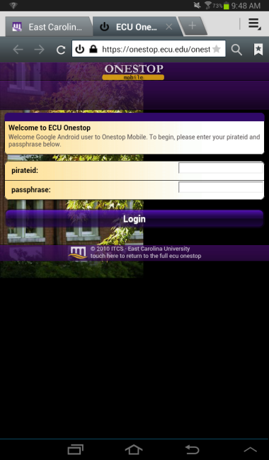
 | Motorola RAZR M | Samsung Galaxy Tab 2
App homepage
OneStop Mobile log in *Labels for credentials are not lined up correctly on smartphone*

Slide 18
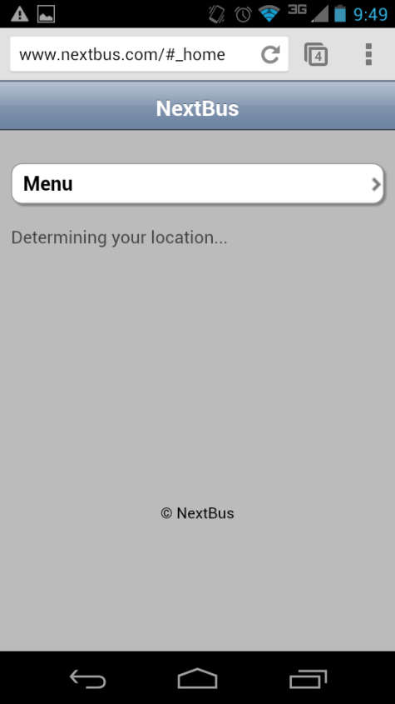
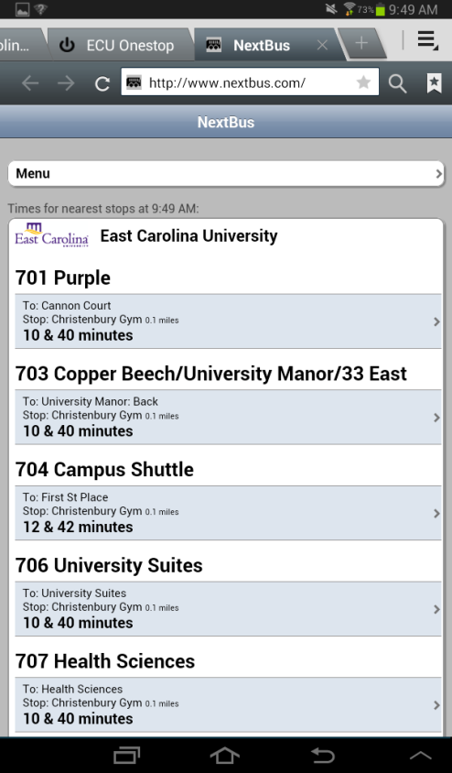
 | Motorola RAZR M | Samsung Galaxy Tab 2
Navigation to transit home page was delayed for smartphone by more than 2 minutes

Slide 19
References
http://developer.android.com/tools/help/monkeyrunner_concepts.html#APIClasses
http://developer.android.com/sdk/index.html
https://code.google.com/p/robotium/
https://cloud.testdroid.com/web/home
Oleksii Starov, Sergiy Vilkomir, and Vyacheslav Kharchenko, "Cloud Testing for Mobile Software Systems: Concept and Prototyping", Proceedings of the 8th International Conference on Software Engineering and Applications (ICSOFT-EA 2013), Reykjavik, Iceland, July 29-31, 2013.

